Slide 1
Environmental and Natural Resources management 2013
Mr. Johnson
Covington FFA

Slide 2
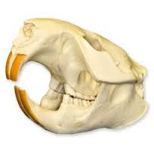

Slide 3
203-Beaver Skull

Slide 4
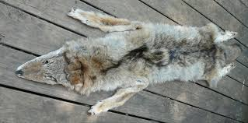

Slide 5
211-coyote pelt

Slide 6
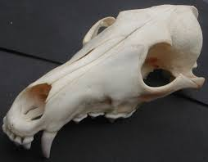
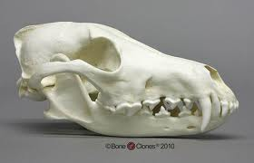
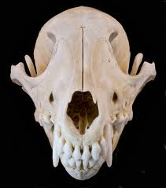

Slide 7
Coyote skull
COYOTE SKULL

Slide 8
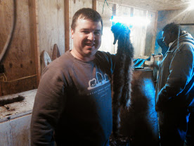
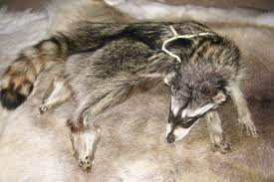
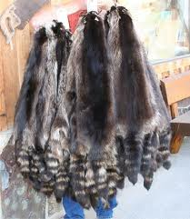

Slide 9
230-raccoon pelt

Slide 10
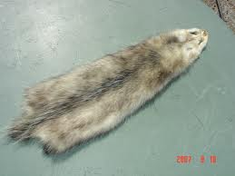
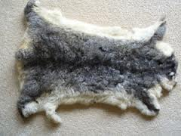

Slide 11
OPPOSUM HIDE

Slide 12
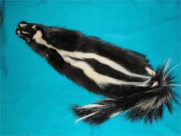
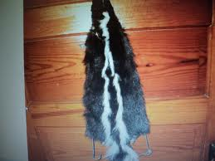

Slide 13
232-skunk hide

Slide 14
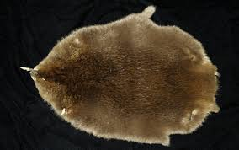
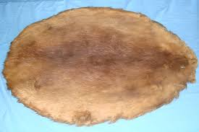
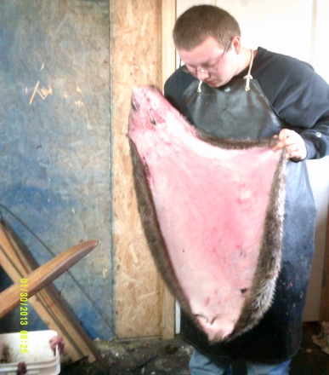

Slide 15
203-beaver hide
BEAVER HIDE

Slide 16
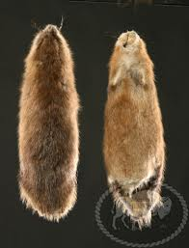
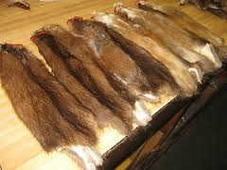

Slide 17
Muskrat hide

Slide 18
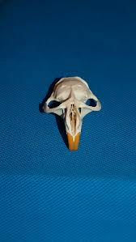
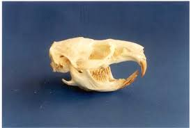

Slide 19
Muskrat skull

Slide 20
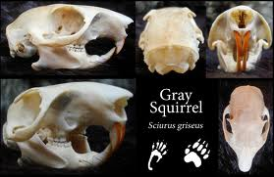
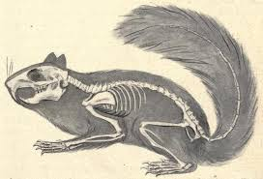
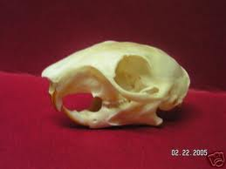

Slide 21
Grey squirrel skull

Slide 23
WOODCHUCK TRACKS

Slide 24
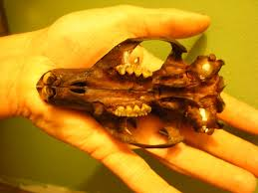
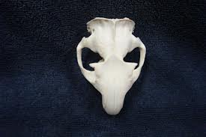

Slide 25
WOODCHUCK SKULL

Slide 26
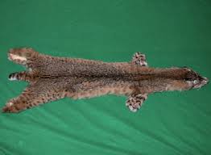
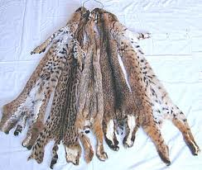
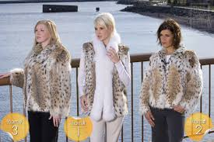

Slide 27
BOBCAT HIDE

Slide 28
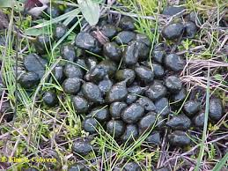
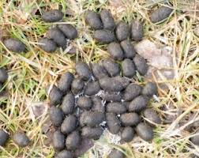

Slide 29
WHITE TAIL DEER SCAT

Slide 30
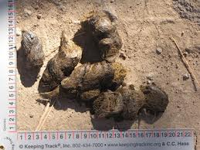
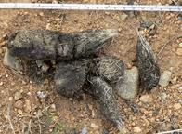

Slide 31
Grey wolf scat

Slide 32
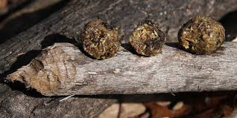
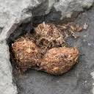

Slide 33
Beaver Scat

Slide 34
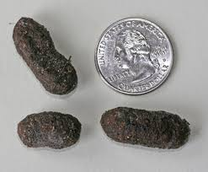
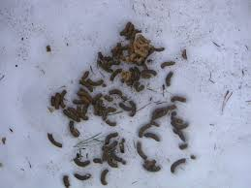
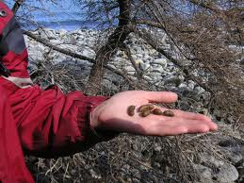

Slide 35
Porcupine scat

Slide 36
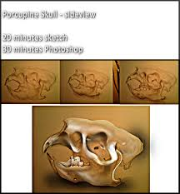
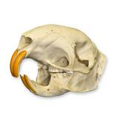
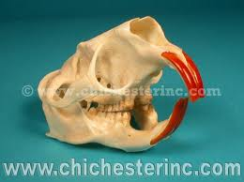

Slide 37
Porcupine skull

Slide 38
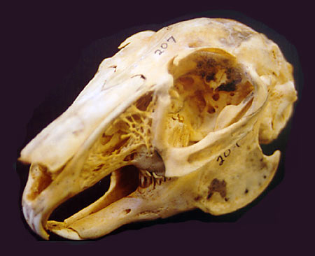
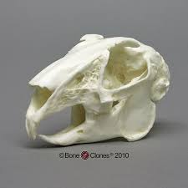

Slide 39
Jack rabbit skull

Slide 40
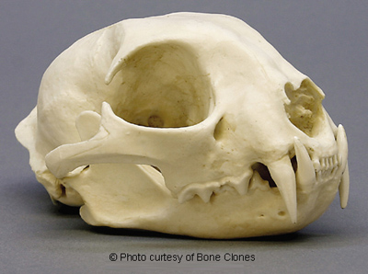
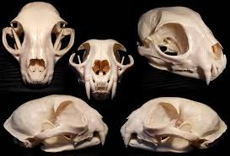

Slide 41
Bobcat skull

Slide 42
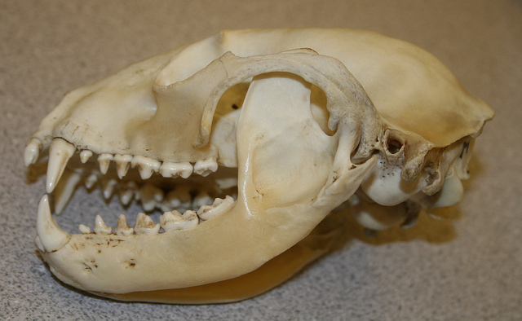
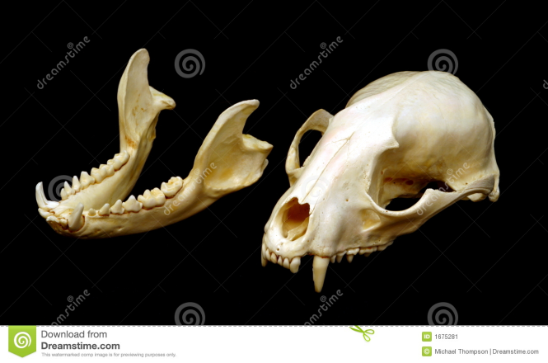

Slide 43
Raccoon skull

Slide 44
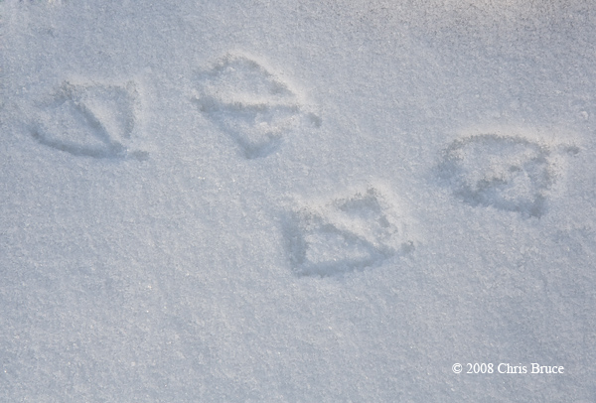
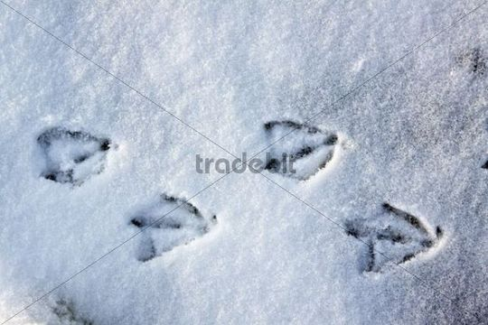

Slide 45
Mallard track

Slide 46
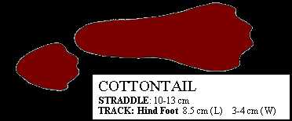

Slide 47
Cotton tail track

Slide 48
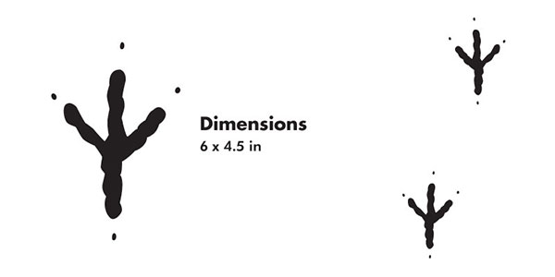
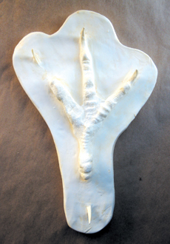

Slide 49
Bald eagle tracks

Slide 51
White tail deer jaw bone

Slide 53
Wood duck mount

Slide 55
White tail deer antlers

Slide 57
Muskrat scat

Slide 59
Cottontail scat

Slide 61
ELK SKUll

Slide 63
Chipmunk scat

Slide 65
Wolf track

Slide 68
203-Beaver tracks

Slide 70
312-Great horned owl

Slide 72
231-Fox squirrel hide

Slide 74
231-Red fox hide

Slide 76
227-Porcupine track

Slide 78
235-Woodchuck track

Slide 80
230-Raccoon track

Slide 82
317-Mallard duck mount

Slide 84
116-Mammal traps

Slide 86
109-Fish measuring board

Slide 88
323-Sandhill crane

Slide 90
206-Black bear skull

Slide 92
115-binoculars

Slide 94
321-QUAIL WING

Slide 95
What do I say?

Slide 96
231-Red fox

Slide 98
325-Turkey Spurs

Slide 100
320-Quail

Slide 102
702-ASIAN Long HORNED BEETLE

Slide 104
709-Feral Hog

